Slide 1


microbiology
Chapter 2 HOW WE SEE THE INVISIBLE WORLD
PowerPoint Image Slideshow

Slide 2

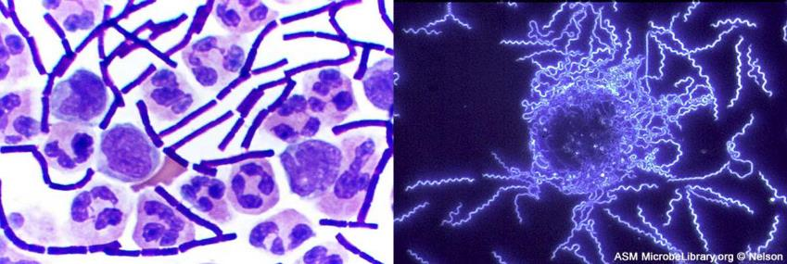
Figure 2.1
Different types of microscopy are used to visualize different structures. Brightfield microscopy (left) renders a darker image on a lighter background, producing a clear image of these Bacillus anthracis cells in cerebrospinal fluid (the rod-shaped bacterial cells are surrounded by larger white blood cells). Darkfield microscopy (right) increases contrast, rendering a brighter image on a darker background, as demonstrated by this image of the bacterium Borrelia burgdorferi, which causes Lyme disease. (credit left: modification of work by Centers for Disease Control and Prevention; credit right: modification of work by American Society for Microbiology)

Slide 3
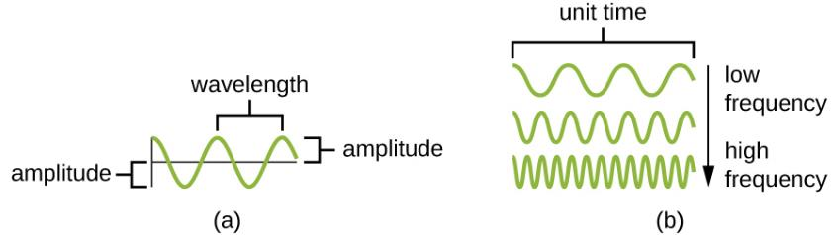
Figure 2.2
The amplitude is the height of a wave, whereas the wavelength is the distance between one peak and the next.
These waves have different frequencies, or rates of vibration. The wave at the top has the lowest frequency, since it has the fewest peaks per unit time. The wave at the bottom has the highest frequency.

Slide 4
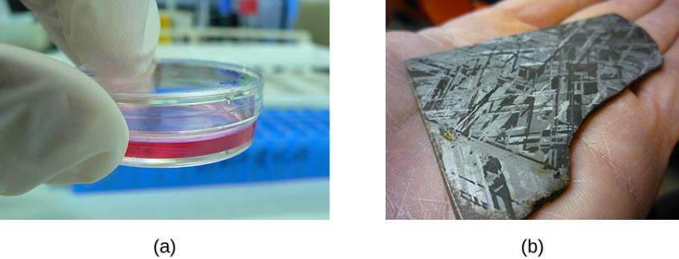
Figure 2.3
A Petri dish is made of transparent plastic or glass, which allows transmission of a high proportion of light. This transparency allows us to see through the sides of the dish to view the contents.
This slice of an iron meteorite is opaque (i.e., it has opacity). Light is not transmitted through the material, making it impossible to see the part of the hand covered by the object. (credit a: modification of work by Umberto Salvagnin; credit b: modification of work by “Waifer X”/Flickr)

Slide 5
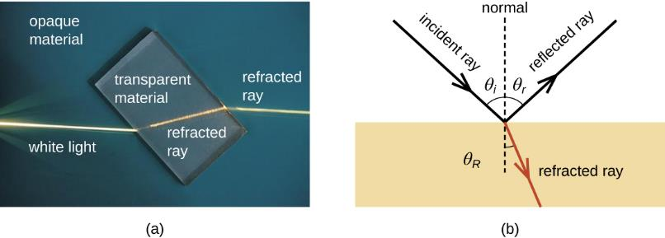
Figure 2.4
Refraction occurs when light passes from one medium, such as air, to another, such as glass, changing the direction of the light rays.
As shown in this diagram, light rays passing from one medium to another may be either refracted or reflected.

Slide 6
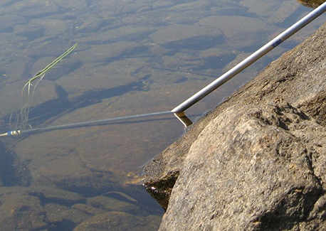
Figure 2.5
This straight pole appears to bend at an angle as it enters the water. This optical illusion is due to the large difference between the refractive indices of air and water.

Slide 7
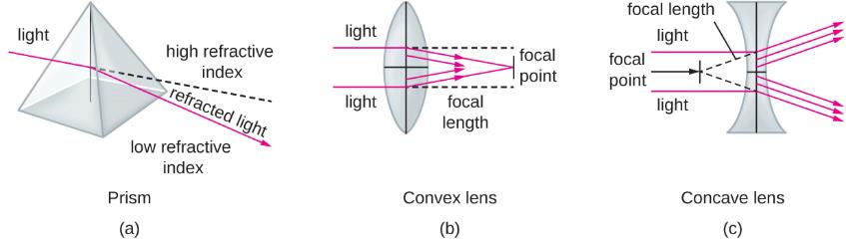
Figure 2.6
A lens is like a collection of prisms, such as the one shown here.
When light passes through a convex lens, it is refracted toward a focal point on the other side of the lens. The focal length is the distance to the focal point.
Light passing through a concave lens is refracted away from a focal point in front of the lens.

Slide 8
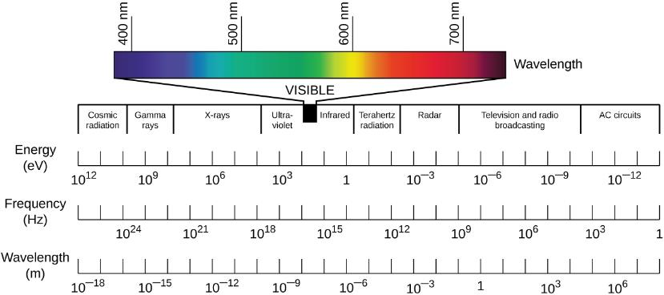
Figure 2.7
The electromagnetic spectrum ranges from high-frequency gamma rays to low-frequency radio waves. Visible light is the relatively small range of electromagnetic frequencies that can be sensed by the human eye. On the electromagnetic spectrum, visible light falls between ultraviolet and infrared light. (credit: modification of work by Johannes Ahlmann)

Slide 9
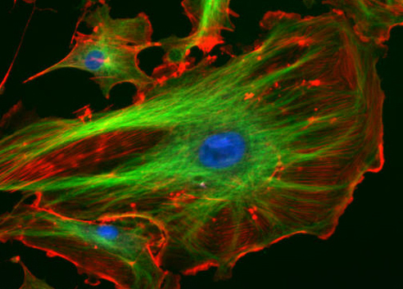
Figure 2.8
The fluorescent dyes absorbed by these bovine pulmonary artery endothelial cells emit brilliant colors when excited by ultraviolet light under a fluorescence microscope. Various cell structures absorb different dyes. The nuclei are stained blue with 4’,6-diamidino-2-phenylindole (DAPI); microtubles are marked green by an antibody bound to FITC; and actin filaments are labeled red with phalloidin bound to tetramethylrhodamine (TRITC). (credit: National Institutes of Health)

Slide 10
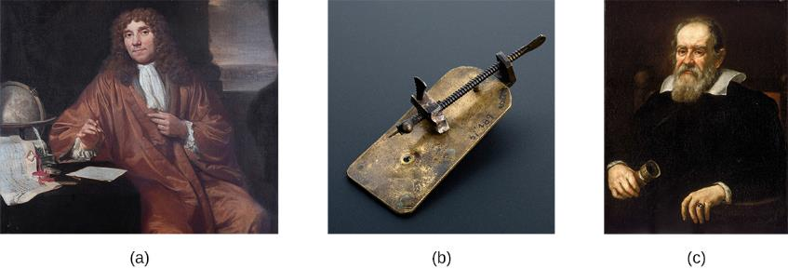
Figure 2.9
Antonie van Leeuwenhoek (1632–1723) is credited as being the first person to observe microbes, including bacteria, which he called “animalcules” and “wee little beasties.”
Even though van Leeuwenhoek’s microscopes were simple microscopes (as seen in this replica), they were more powerful and provided better resolution than the compound microscopes of his day.
Though more famous for developing the telescope, Galileo Galilei (1564–1642) was also one of the pioneers of microscopy. (credit b: modification of work by “Wellcome Images”/Wikimedia Commons)

Slide 11
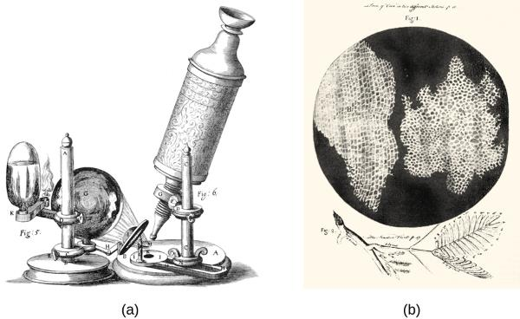
Figure 2.10
Robert Hooke used his (a) compound microscope to view (b) cork cells. Both of these engravings are from his seminal work Micrographia, published in 1665.

Slide 12
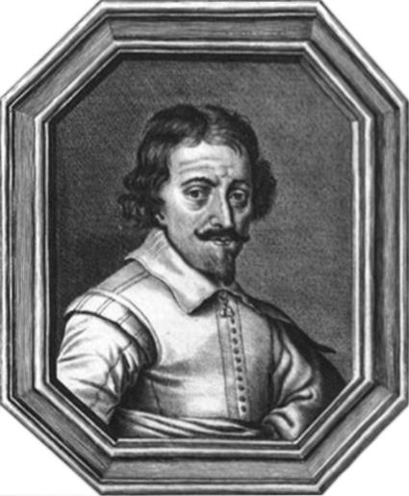
Figure 2.11
Zaccharias Janssen, along with his father Hans, may have invented the telescope, the simple microscope, and the compound microscope during the late 1500s or early 1600s. The historical evidence is inconclusive.

Slide 13
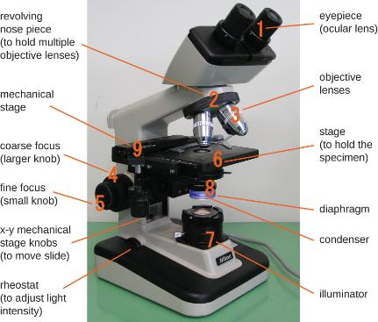
Figure 2.12
Components of a typical brightfield microscope.

Slide 14
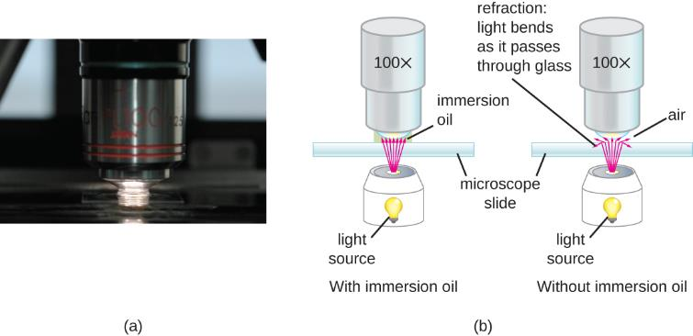
Figure 2.13
Oil immersion lenses like this one are used to improve resolution.
Because immersion oil and glass have very similar refractive indices, there is a minimal amount of refraction before the light reaches the lens. Without immersion oil, light scatters as it passes through the air above the slide, degrading the resolution of the image.

Slide 15
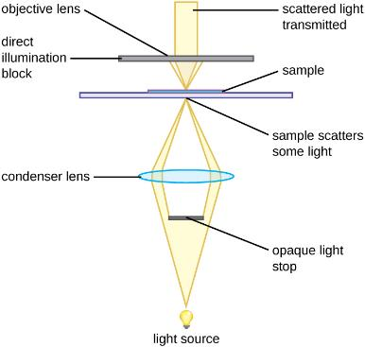
Figure 2.14
An opaque light stop inserted into a brightfield microscope is used to produce a darkfield image. The light stop blocks light traveling directly from the illuminator to the objective lens, allowing only light reflected or refracted off the specimen to reach the eye.

Slide 16
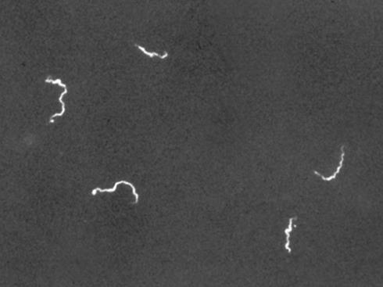
Figure 2.15
Use of a darkfield microscope allows us to view living, unstained samples of the spirochete Treponema pallidum. Similar to a photographic negative, the spirochetes appear bright against a dark background. (credit: Centers for Disease Control and Prevention)

Slide 17
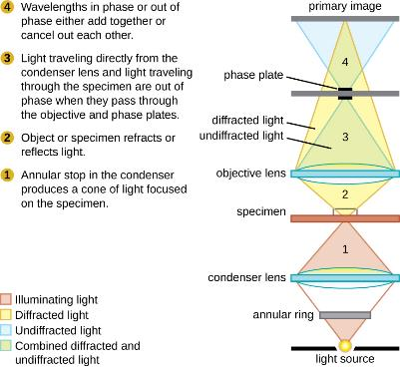
Figure 2.16
This diagram of a phase-contrast microscope illustrates phase differences between light passing through the object and background. These differences are produced by passing the rays through different parts of a phase plate. The light rays are superimposed in the image plane, producing contrast due to their interference.

Slide 18
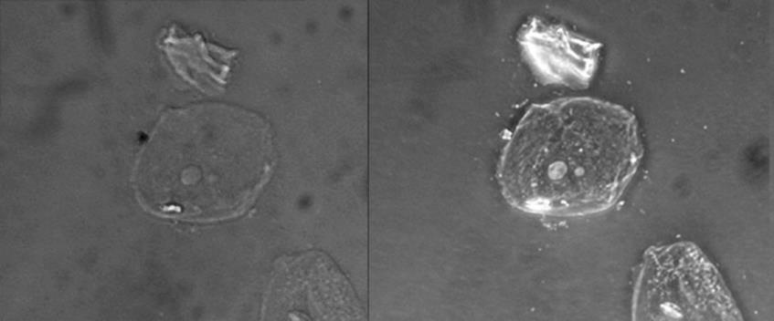
Figure 2.17
This figure compares a brightfield image (left) with a phase-contrast image (right) of the same unstained simple squamous epithelial cells. The cells are in the center and bottom right of each photograph (the irregular item above the cells is acellular debris). Notice that the unstained cells in the brightfield image are almost invisible against the background, whereas the cells in the phase-contrast image appear to glow against the background, revealing far more detail.

Slide 19
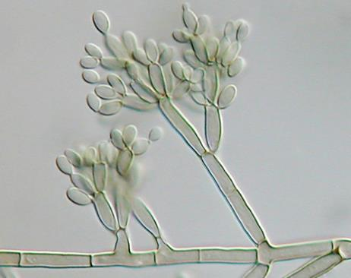
Figure 2.18
A DIC image of Fonsecaea pedrosoi grown on modified Leonian’s agar. This fungus causes chromoblastomycosis, a chronic skin infection common in tropical and subtropical climates.

Slide 20
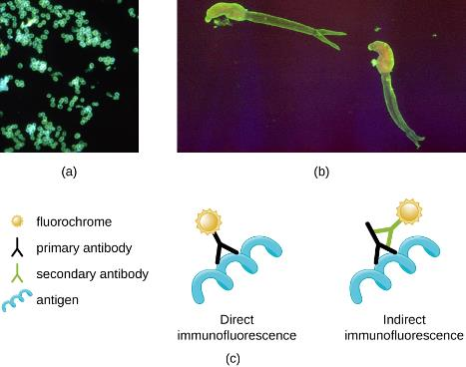
Figure 2.19
A direct immunofluorescent stain is used to visualize Neisseria gonorrhoeae, the bacterium that causes gonorrhea.
An indirect immunofluorescent stain is used to visualize larvae of Schistosoma mansoni, a parasitic worm that causes schistosomiasis, an intestinal disease common in the tropics. In direct immunofluorescence, the stain is absorbed by a primary antibody, which binds to the antigen.
In indirect immunofluorescence, the stain is absorbed by a secondary antibody, which binds to a primary antibody, which, in turn, binds to the antigen. (credit a: modification of work by Centers for Disease Control and Prevention; credit b: modification of work by Centers for Disease Control and Prevention)

Slide 21
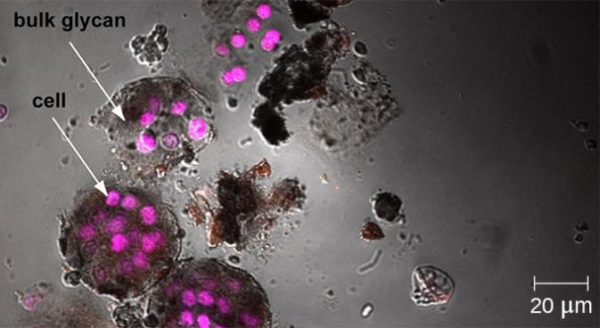
Figure 2.20
Confocal microscopy can be used to visualize structures such as this roof-dwelling cyanobacterium biofilm. (credit: modification of work by American Society for Microbiology)

Slide 22
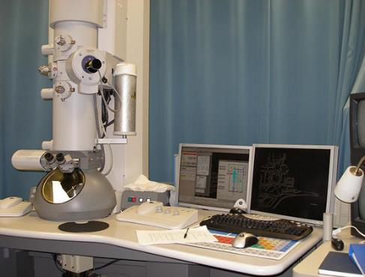
Figure 2.21
A transmission electron microscope (TEM).

Slide 23
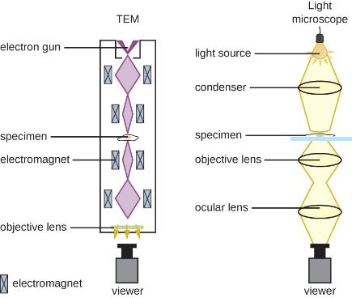
Figure 2.22
Electron microscopes use magnets to focus electron beams similarly to the way that light microscopes use lenses to focus light.

Slide 24
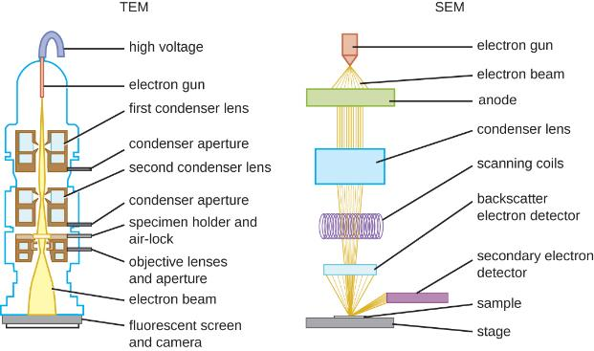
Figure 2.23
These schematic illustrations compare the components of transmission electron microscopes and scanning electron microscopes.

Slide 25
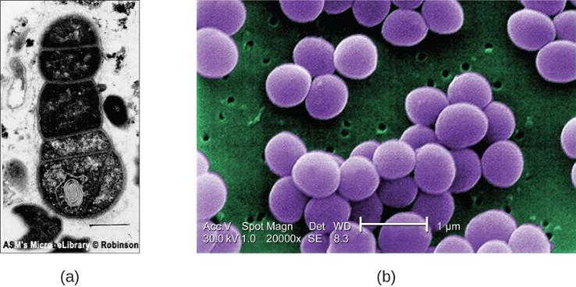
Figure 2.24
This TEM image of cells in a biofilm shows well-defined internal structures of the cells because of varying levels of opacity in the specimen.
This color-enhanced SEM image of the bacterium Staphylococcus aureus illustrates the ability of scanning electron microscopy to render three-dimensional images of the surface structure of cells. (credit a: modification of work by American Society for Microbiology; credit b: modification of work by Centers for Disease Control and Prevention)

Slide 26
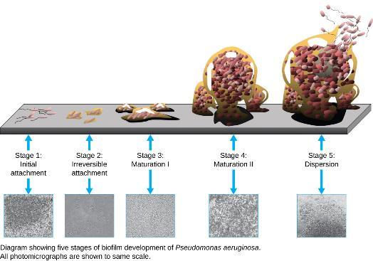
Figure 2.25
A biofilm forms when planktonic (free-floating) bacteria of one or more species adhere to a surface, produce slime, and form a colony. (credit: Public Library of Science)

Slide 27
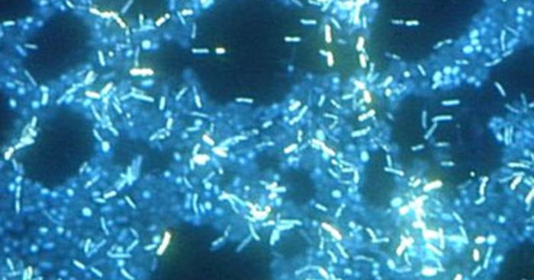
Figure 2.26
In this image, multiple species of bacteria grow in a biofilm on stainless steel (stained with DAPI for epifluorescence miscroscopy). (credit: Ricardo Murga, Rodney Donlan)

Slide 28
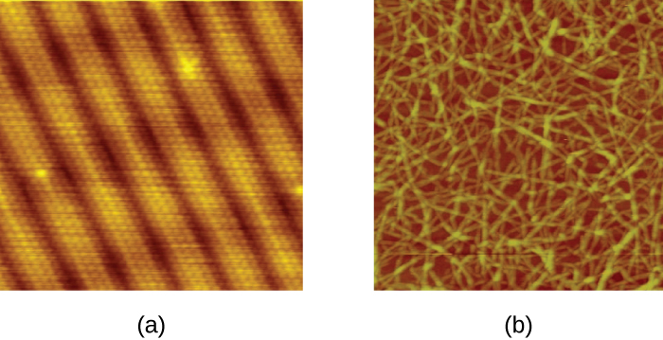
Figure 2.27
STMs and AFMs allow us to view images at the atomic level.
This STM image of a pure gold surface shows individual atoms of gold arranged in columns.
This AFM image shows long, strand-like molecules of nanocellulose, a laboratory-created substance derived from plant fibers. (credit a: modification of work by “Erwinrossen”/Wikimedia Commons)

Slide 29
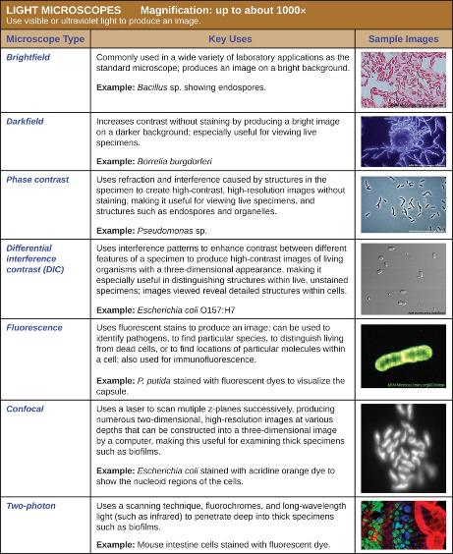
Figure 2.28
(credit “Brightfield”: modification of work by American Society for Microbiology; credit “Darkfield”: modification of work by American Society for Microbiology; credit “Phase contrast”: modification of work by American Society for Microbiology; credit “DIC”: modification of work by American Society for Microbiology; credit “Fluorescence”: modification of work by American Society for Microbiology; credit “Confocal”: modification of work by American Society for Microbiology; credit “Two-photon”: modification of work by Alberto Diaspro, Paolo Bianchini, Giuseppe Vicidomini, Mario Faretta, Paola Ramoino, Cesare Usai)

Slide 30
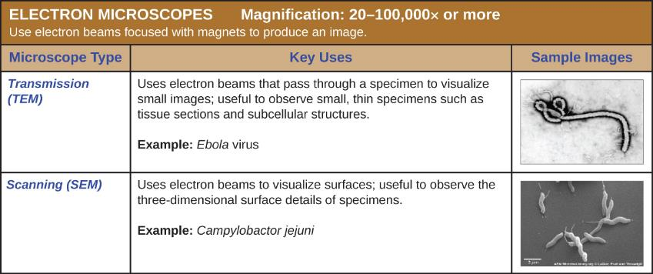
Figure 2.29
(credit “TEM”: modification of work by American Society for Microbiology; credit “SEM”: modification of work by American Society for Microbiology)

Slide 31
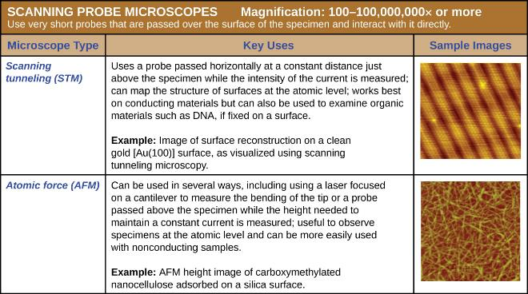
Figure 2.30

Slide 32
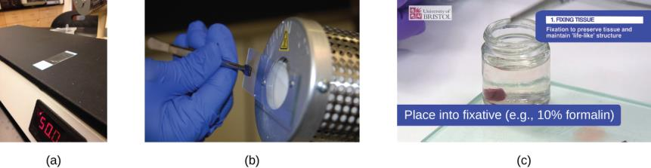
Figure 2.31
A specimen can be heat-fixed by using a slide warmer like this one.
Another method for heat-fixing a specimen is to hold a slide with a smear over a microincinerator.
This tissue sample is being fixed in a solution of formalin (also known as formaldehyde). Chemical fixation kills microorganisms in the specimen, stopping degradation of the tissues and preserving their structure so that they can be examined later under the microscope. (credit a: modification of work by Nina Parker; credit b: modification of “Microbiology Laboratory Manual” by Gary E. Kaiser, PhD; credit c: modification of work by “University of Bristol”/YouTube)

Slide 33
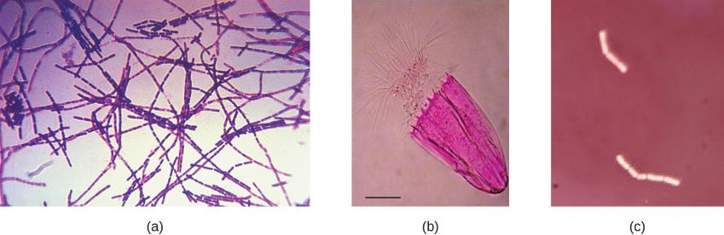
Figure 2.32
These Bacillus anthracis cells have absorbed crystal violet, a basic positive stain.
This specimen of Spinoloricus, a microscopic marine organism, has been stained with rose bengal, a positive acidic stain.
These B. megaterium appear to be white because they have not absorbed the negative red stain applied to the slide. (credit a: modification of work by Centers for Disease Control and Prevention; credit b: modification of work by Roberto Danovaro, Antonio Pusceddu, Cristina Gambi, Iben Heiner, Reinhardt Mobjerg Kristensen; credit c: modification of work by Anh-Hue Tu)

Slide 34
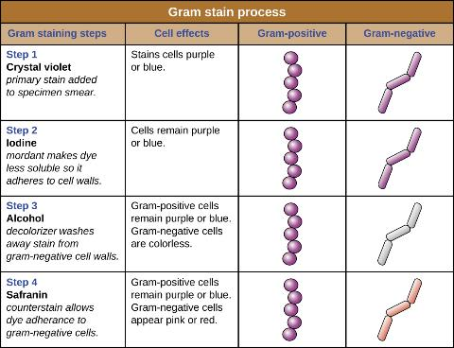
Figure 2.33
Gram-staining is a differential staining technique that uses a primary stain and a secondary counterstain to distinguish between gram-positive and gram-negative bacteria.

Slide 35
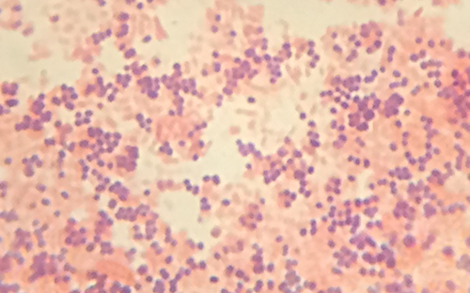
Figure 2.34
In this specimen, the gram-positive bacterium Staphylococcus aureus retains crystal violet dye even after the decolorizing agent is added. Gram-negative Escherichia coli, the most common Gram stain quality-control bacterium, is decolorized, and is only visible after the addition of the pink counterstain safranin. (credit: modification of work by Nina Parker)

Slide 36
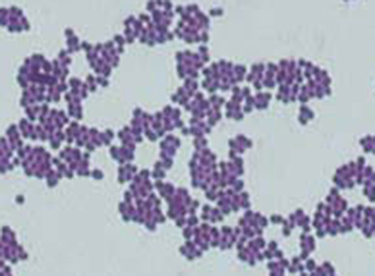
Figure 2.35
(credit: modification of work by American Society for Microbiology)

Slide 37
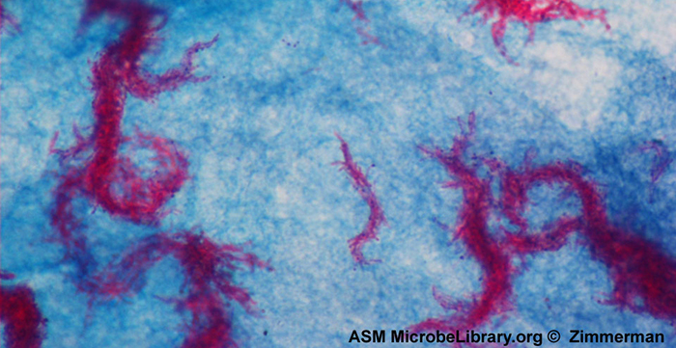
Figure 2.36
Ziehl-Neelsen staining has rendered these Mycobacterium tuberculosis cells red and the surrounding growth indicator medium blue. (credit: modification of work by American Society for Microbiology)

Slide 38
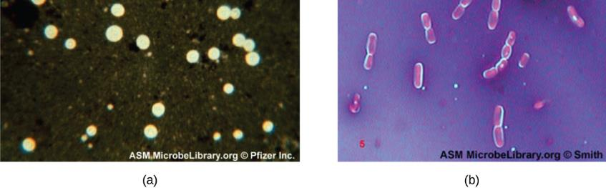
Figure 2.37
India-ink was used to stain the background around these cells of the yeast Cryptococcus neoformans. The halos surrounding the cells are the polysaccharide capsules.
Crystal violet and copper sulfate dyes cannot penetrate the encapsulated Bacillus cells in this negatively stained sample. Encapsulated cells appear to have a light-blue halo. (credit a: modification of work by American Society for Microbiology; credit b: modification of work by American Society for Microbiology)

Slide 39
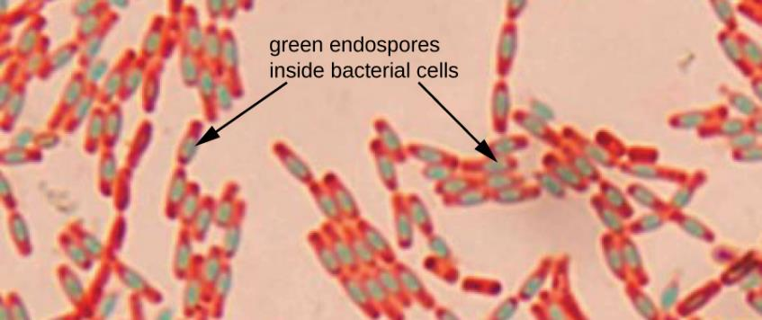
Figure 2.38
A stained preparation of Bacillus subtilis showing endospores as green and the vegetative cells as pink. (credit: modification of work by American Society for Microbiology)

Slide 40
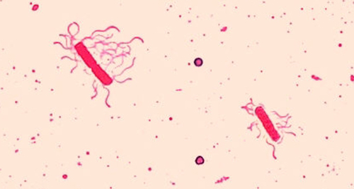
Figure 2.39
A flagella stain of Bacillus cereus, a common cause of foodborne illness, reveals that the cells have numerous flagella, used for locomotion. (credit: modification of work by Centers for Disease Control and Prevention)

Slide 41
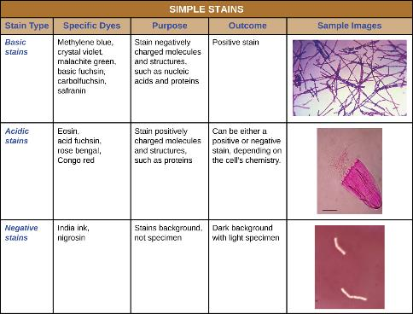
Figure 2.40
(credit “basic stains”: modification of work by Centers for Disease Control and Prevention; credit “Acidic stains”: modification of work by Roberto Danovaro, Antonio Dell’Anno, Antonio Pusceddu, Cristina Gambi, Iben Heiner, Reinhardt Mobjerg Kristensen; credit “Negative stains”: modification of work by Anh-Hue Tu)

Slide 42
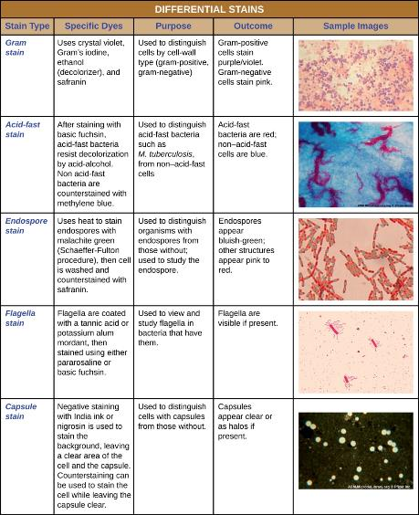
Figure 2.41
(credit “Gram stain”: modification of work by Nina Parker; credit “Acid-fast stain”: modification of work by American Society for Microbiology; credit “Endospore stain”: modification of work by American Society for Microbiology; credit “Capsule stain” : modification of work by American Society for Microbiology; credit “Flagella stain”: modification of work by Centers for Disease Control and Prevention)

Slide 43
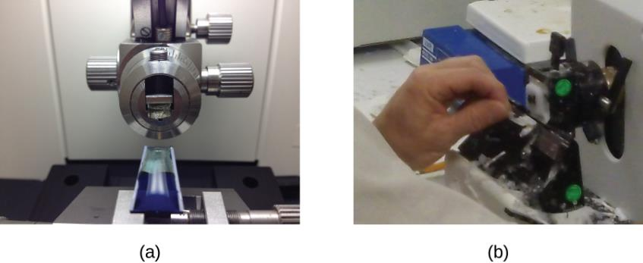
Figure 2.42
An ultramicrotome used to prepare specimens for a TEM.
A technician uses an ultramicrotome to slice a specimen into thin sections. (credit a: modification of work by “Frost Museum”/Flickr; credit b: modification of work by U.S. Fish and Wildlife Service Northeast Region)

Slide 44
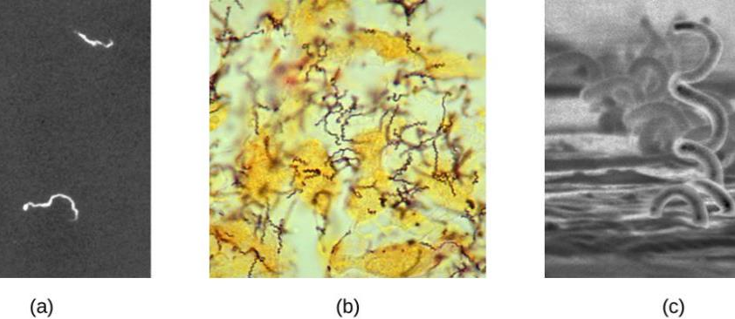
Figure 2.43
Living, unstained Treponema pallidum spirochetes can be viewed under a darkfield microscope.
In this brightfield image, a modified Steiner silver stain is used to visualized T. pallidum spirochetes. Though the stain kills the cells, it increases the contrast to make them more visible.
While not used for standard diagnostic testing, T. pallidum can also be examined using scanning electron microscopy. (credit a: modification of work by Centers for Disease Control and Prevention; credit b: modification of work by Centers for Disease Control and Prevention; credit c: modification of work by Centers for Disease Control and Prevention)

Slide 45
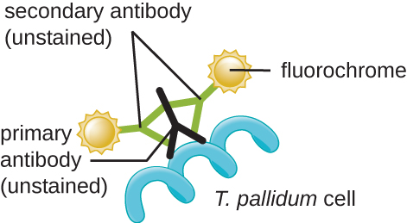
Figure 2.44
Indirect immunofluorescence can be used to identify T. pallidum, the causative agent of syphilis, in a specimen.

Slide 46
This OpenStax ancillary resource is © Rice University under a CC-BY 4.0 International license; it may be reproduced or modified but must be attributed to OpenStax, Rice University and any changes must be noted.

